Slide 1
Shalom Initiative
Transforming and Impacting Lives

Slide 2
The Anglophone Crisis in Cameroon
And
The Respond of Shalom Initiative
By
Vagoga Mary Salle
Founder\Coordinator
Shalom Initiative

Slide 3
Who are we?
SHALOM INNITIATIVE is an action oriented community development organization with a Goal to transform and empower the lives of people in her local community. Shalom encourages and fosters innovation among youths, creative entrepreneurship among young people with a keen consideration to young girls. Shalom is out to practicalise job creation among youths, reduces health issues through awareness, protect the environment as well as foster peace campaigns in her local community. We are building our communities, bringing hope to many, putting smiles on faces and changing the narratives of community development. We are an apolitical association, non-denominational, non-governmental and non-profit making.
We are out to Identify, Develop and empower our local communities

Slide 4
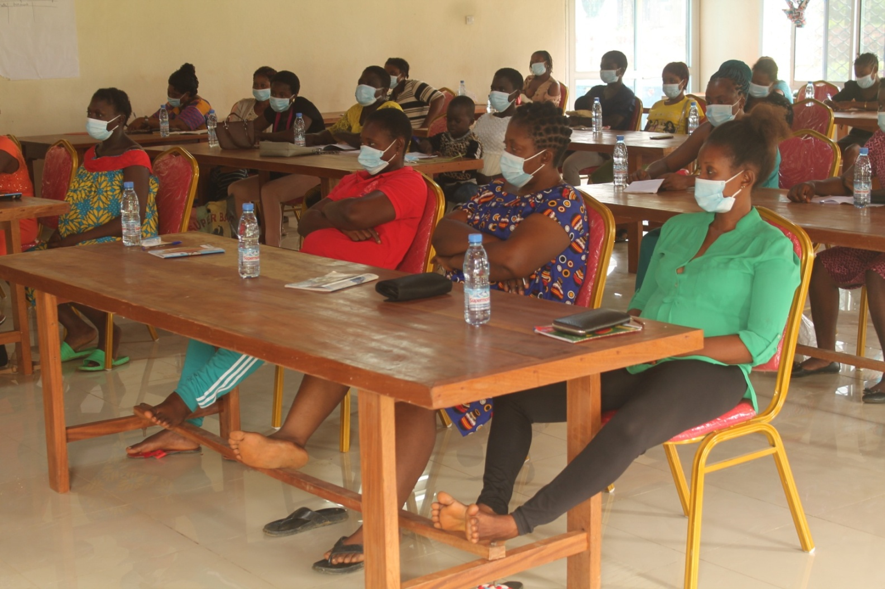
Economic Empowerment: Training on bookkeeping and business management

Slide 5
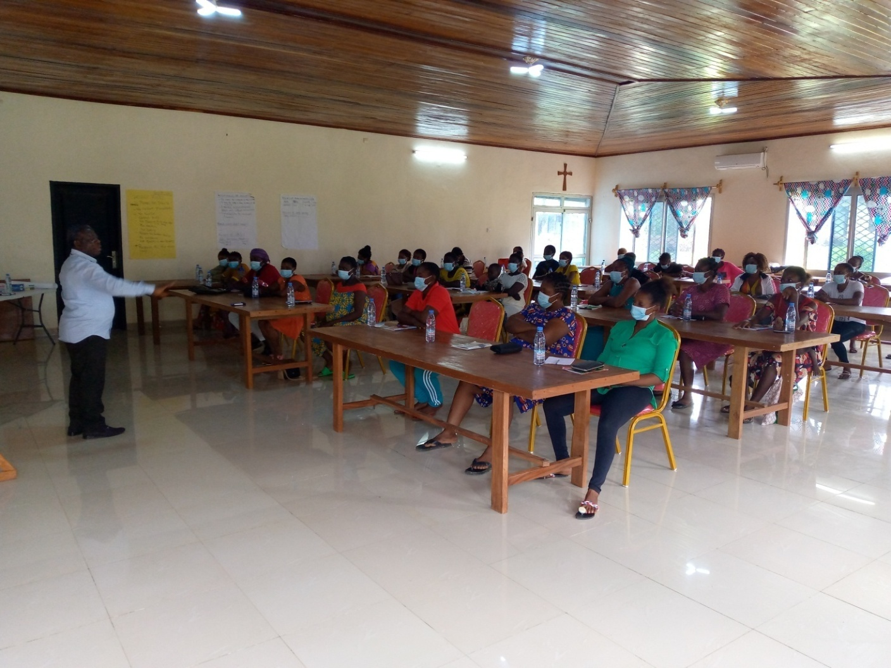
Economic Empowerment: Training on bookkeeping and business management

Slide 6
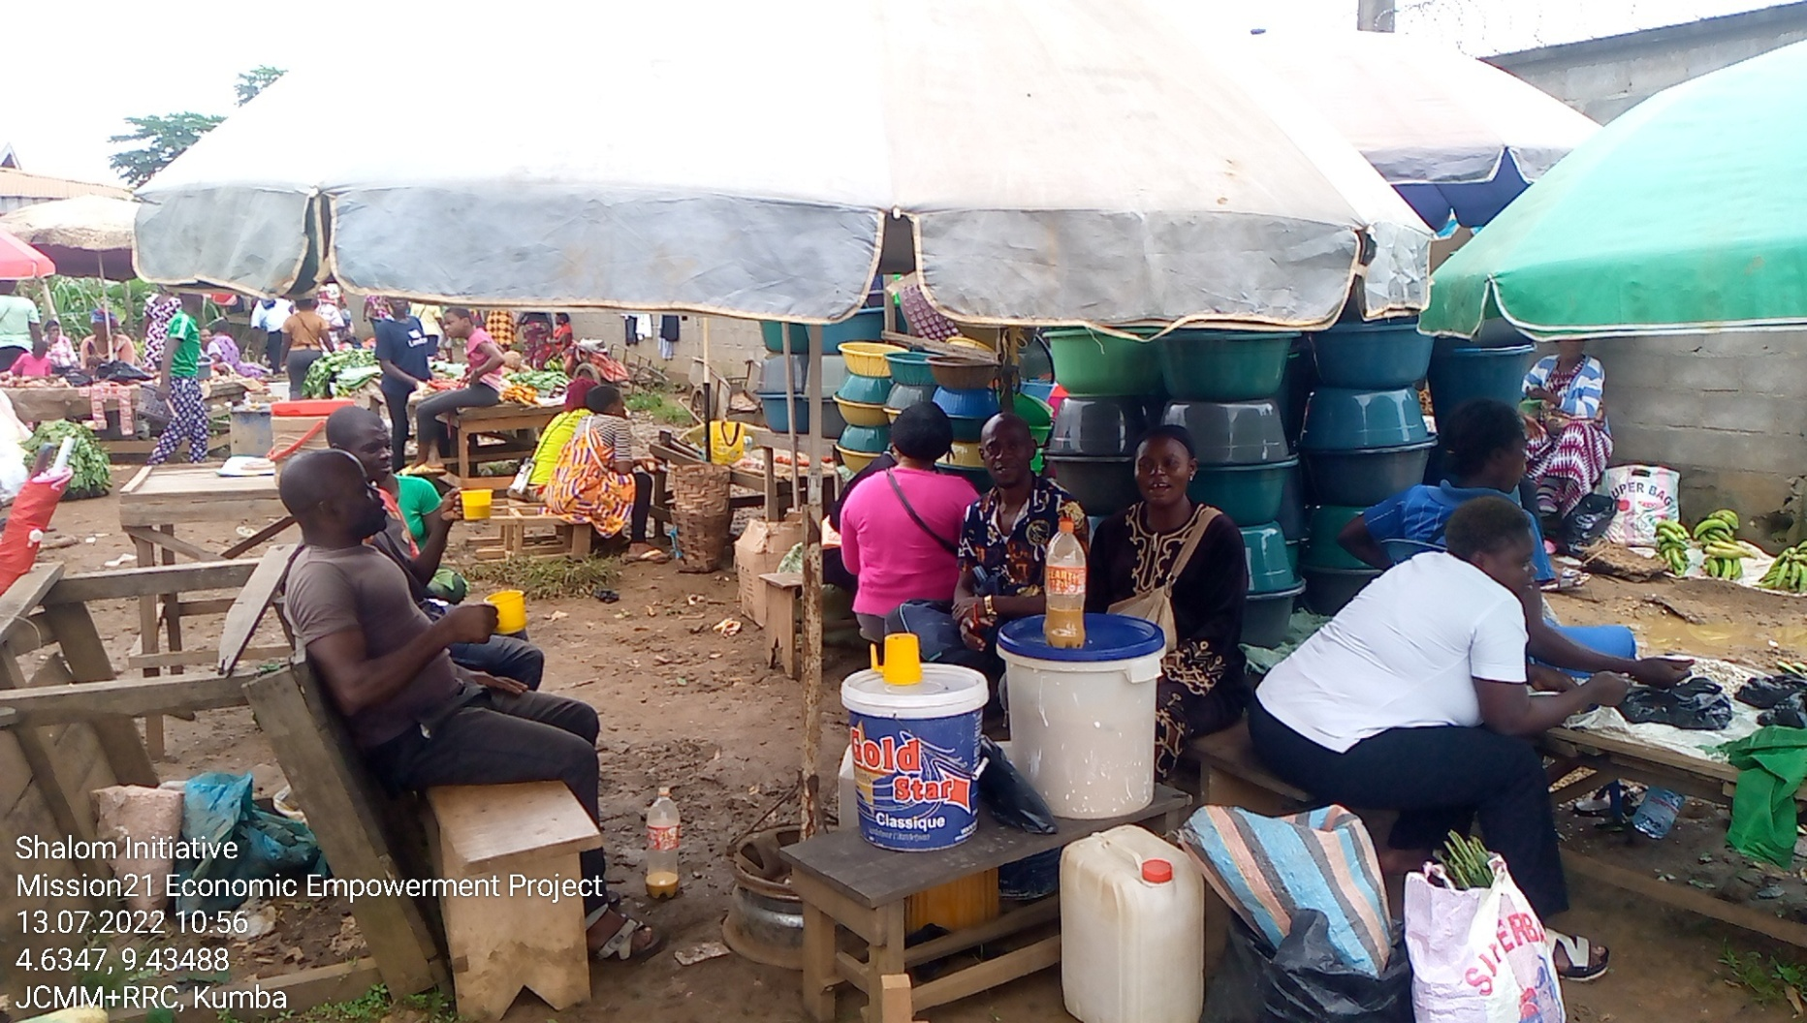
Woman in Business

Slide 7
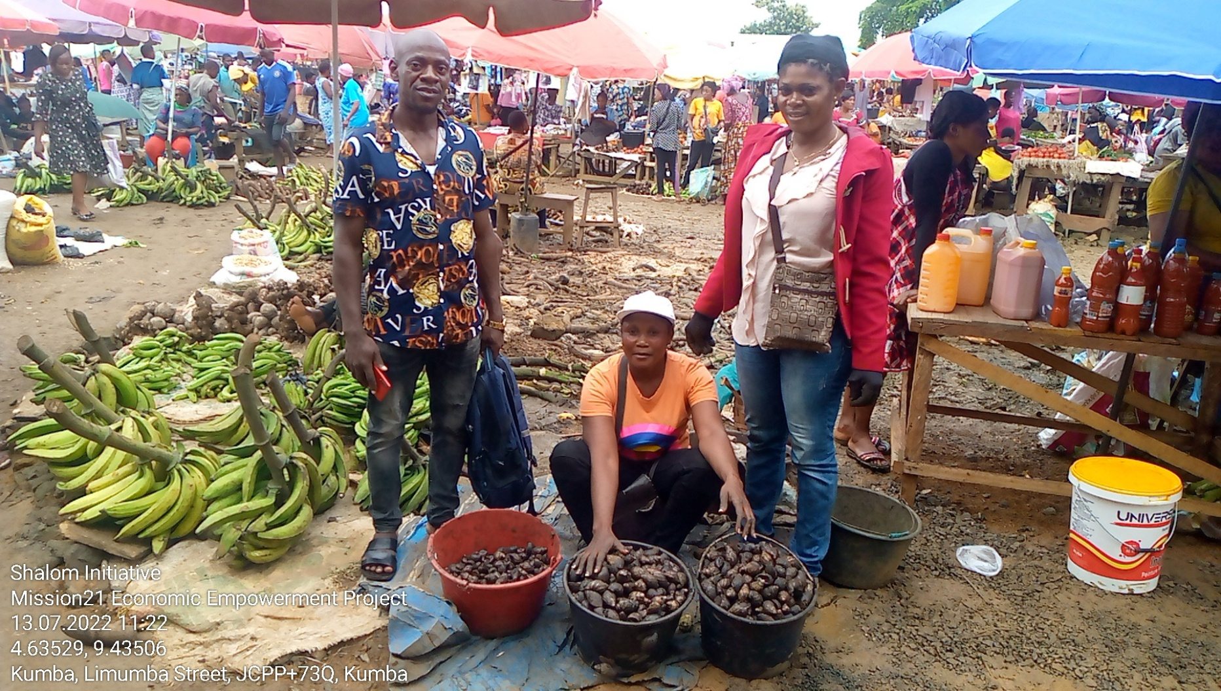
Woman in Business

Slide 8
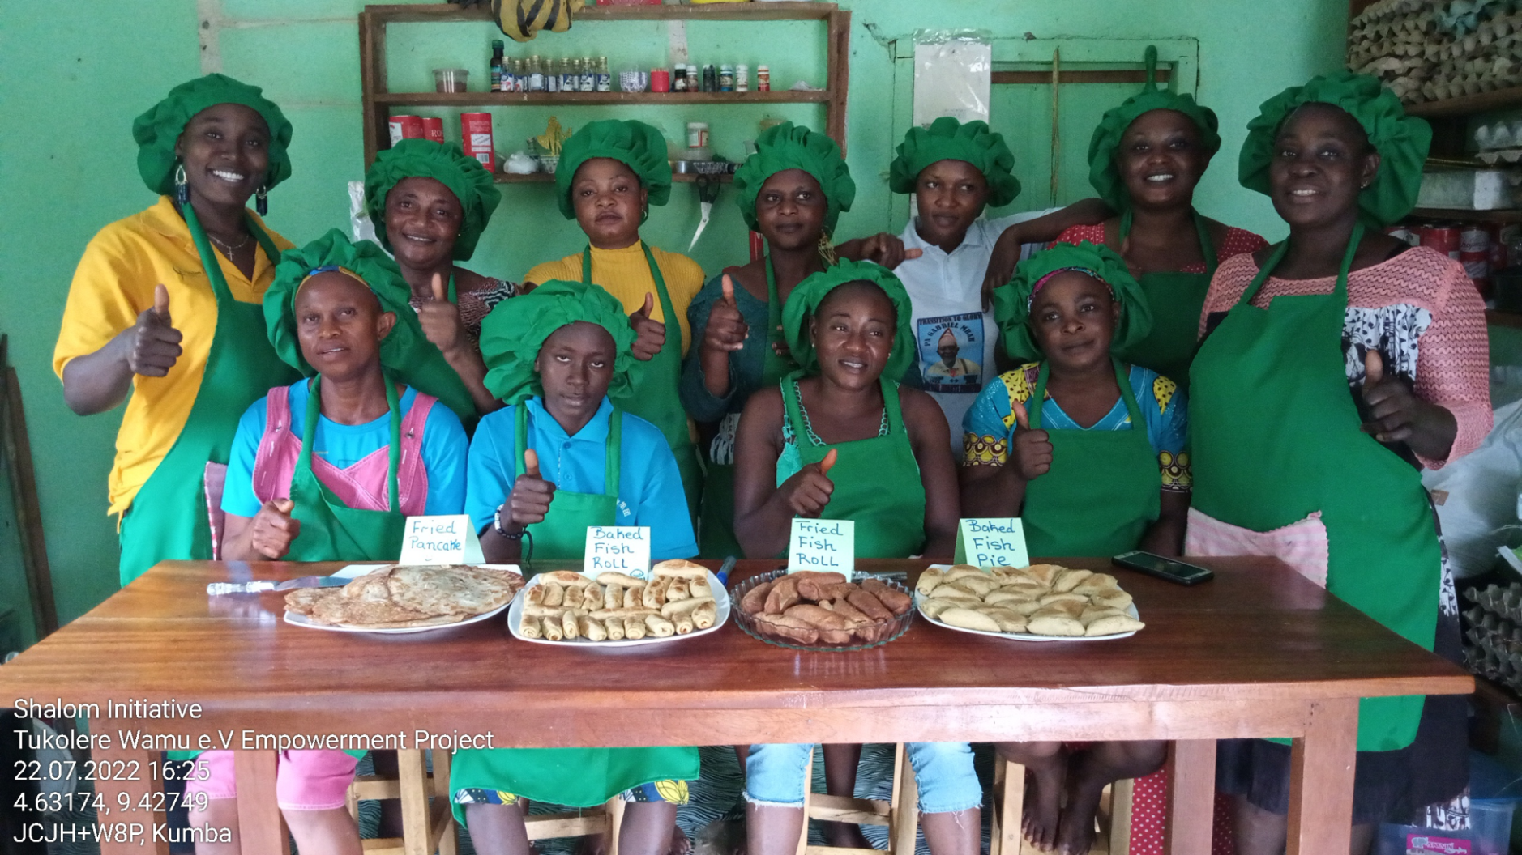
Empowered women with their end products

Slide 9
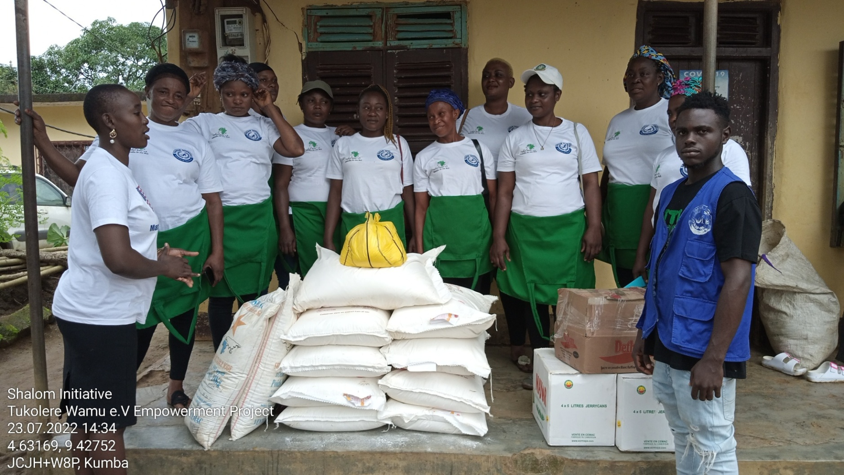
Materials given for their start up

Slide 10
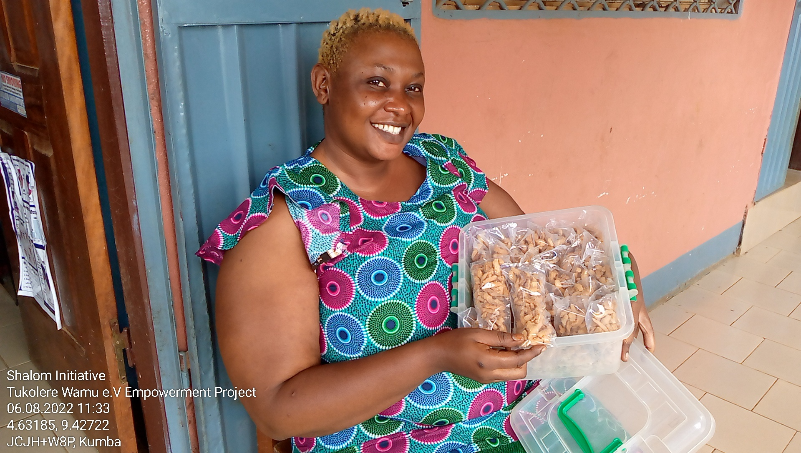
Woman in business

Slide 11
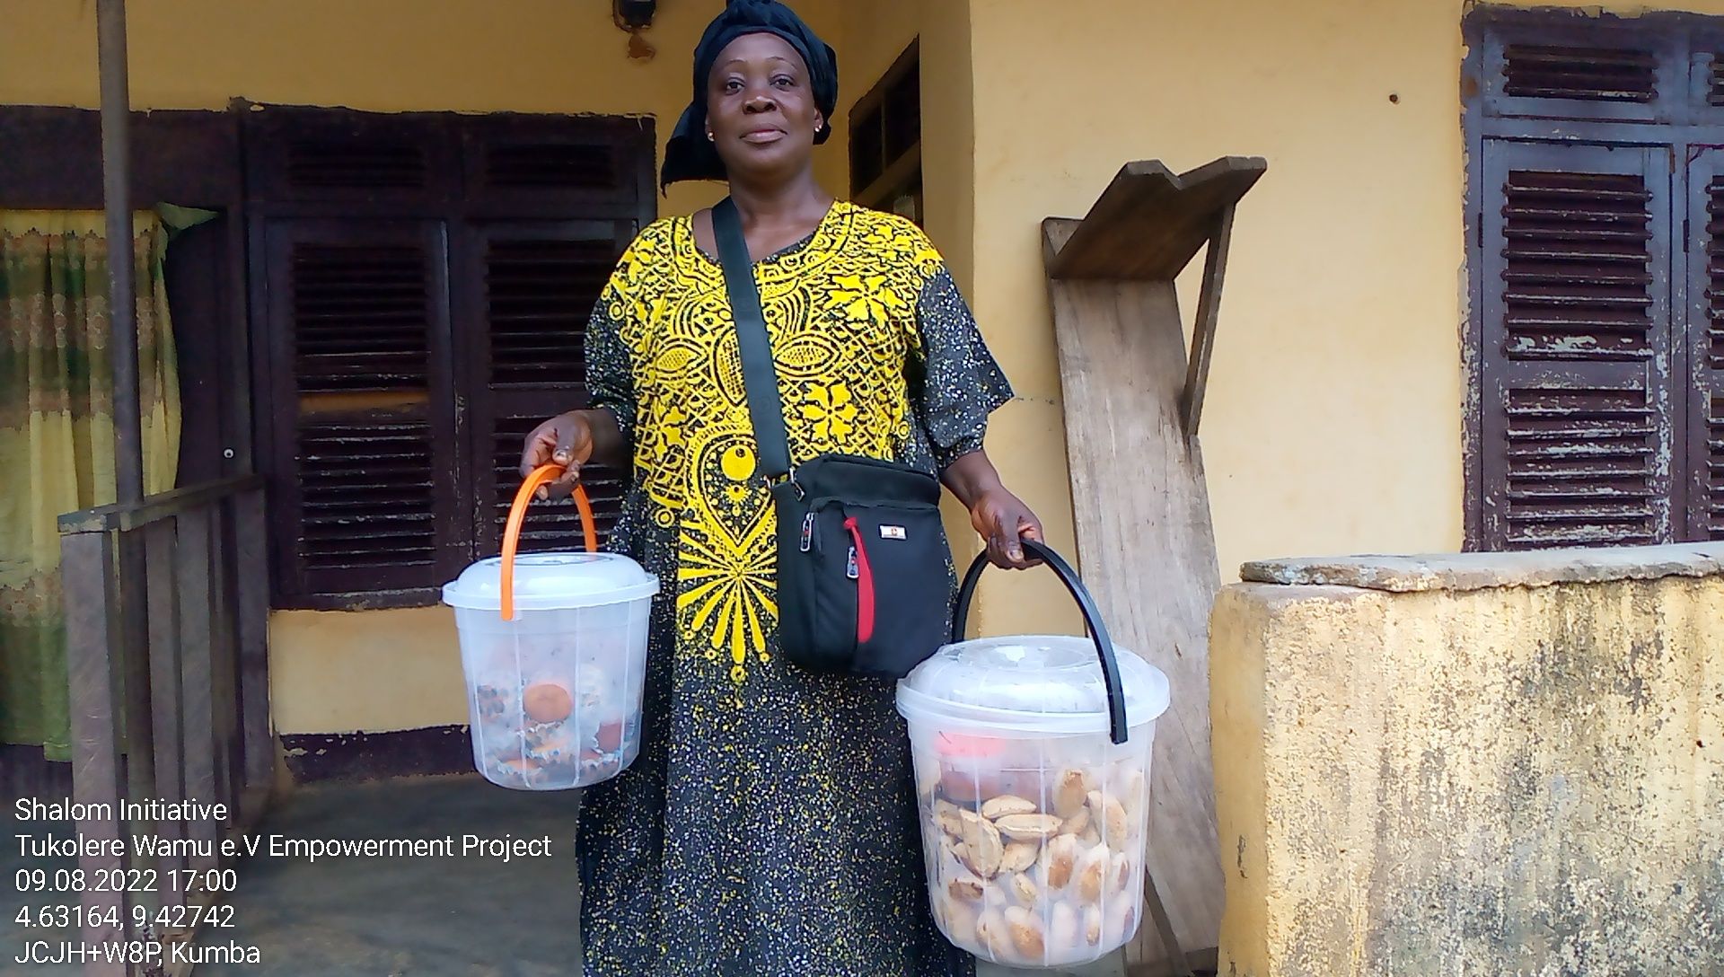
Woman in business

Slide 12
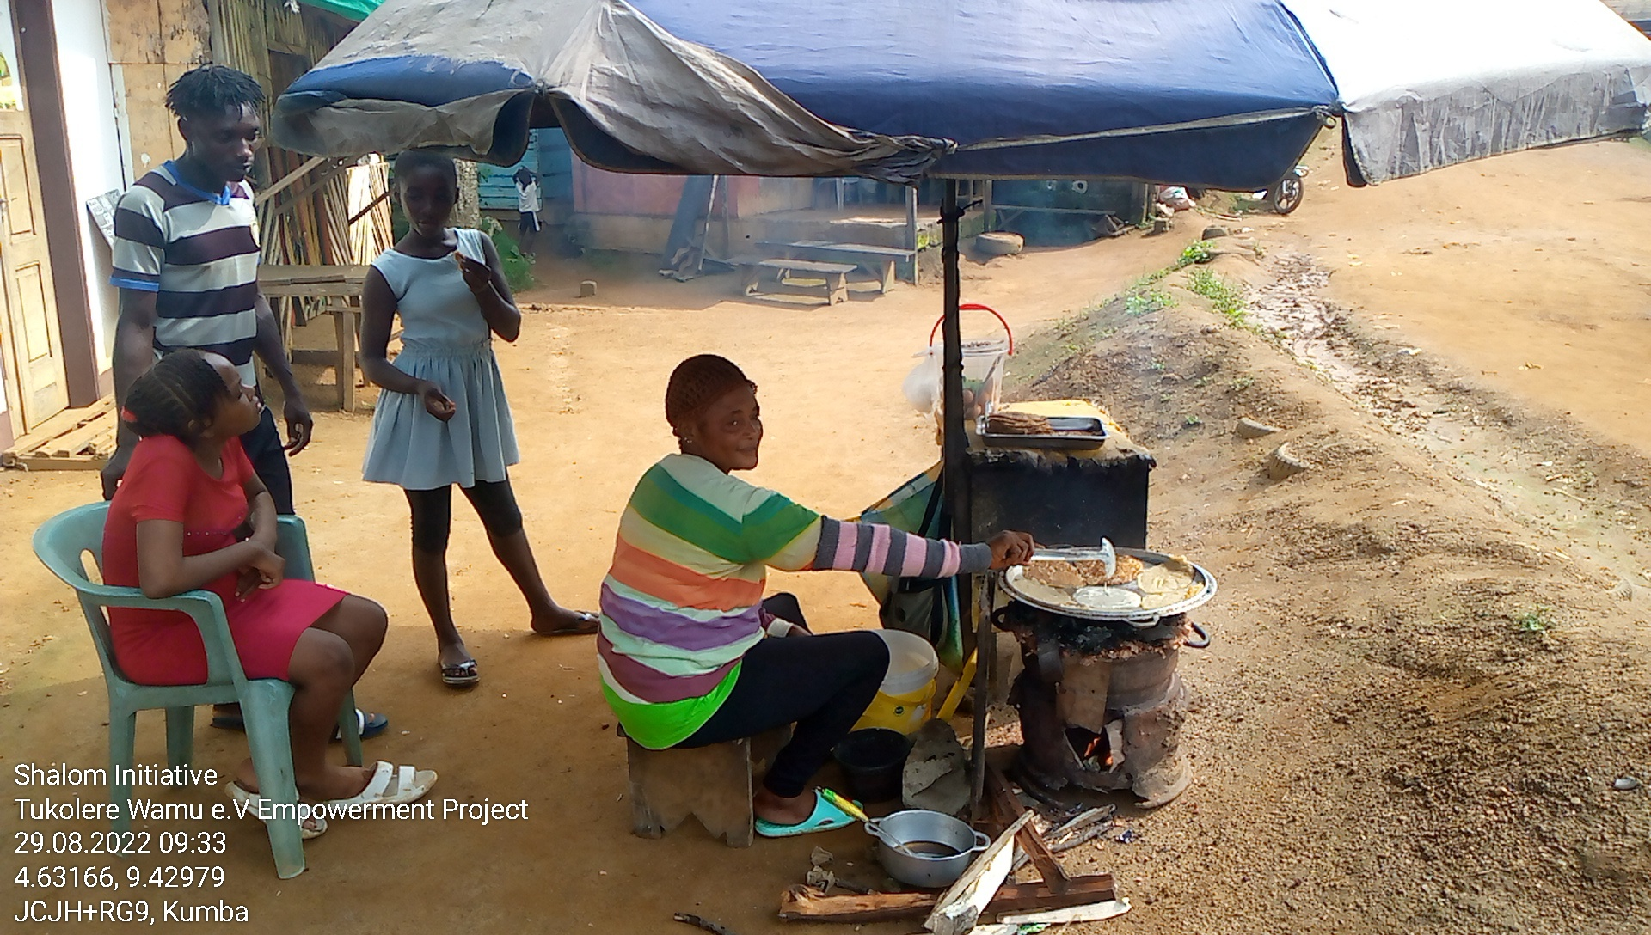
Woman in business

Slide 13
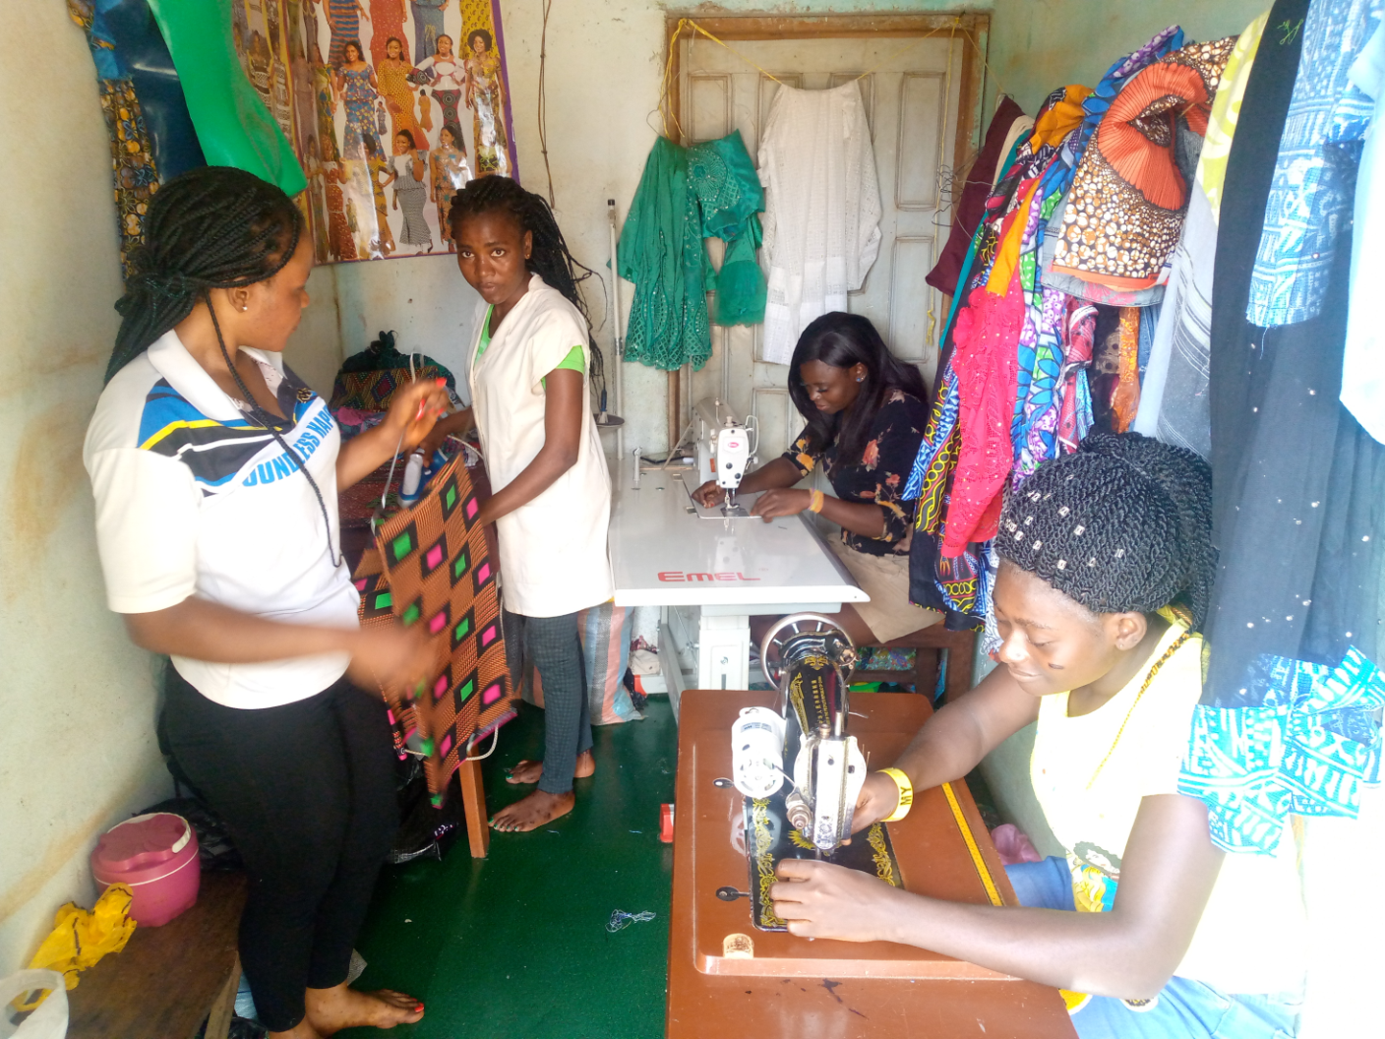
Empowerment: Vocational Training (Dress Designing)

Slide 14
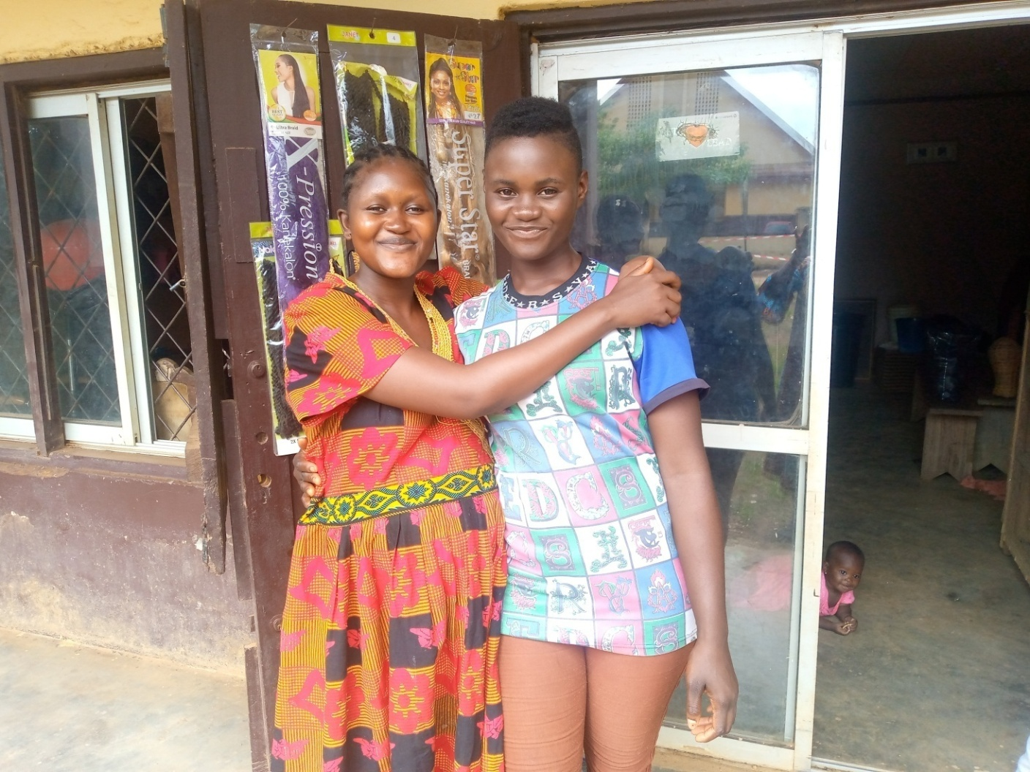
Hair Dressing Trainees

Slide 15
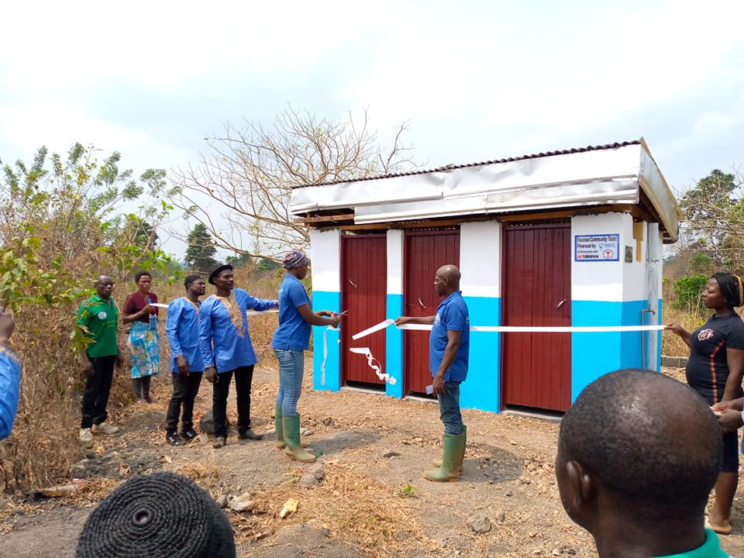
Health Care (water hygiene and sanitation)

Slide 16
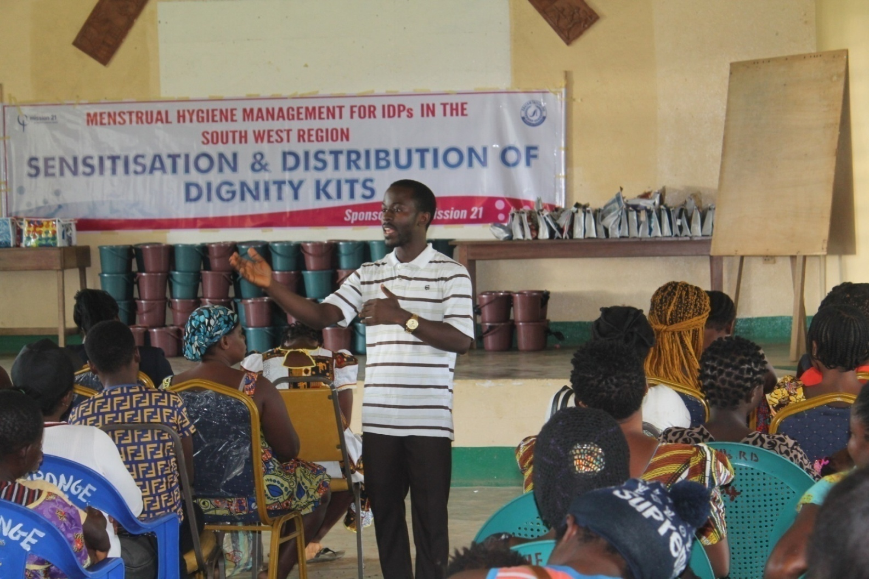
Dr. Mbwoge presenting on Menstral hygiene Management

Slide 17
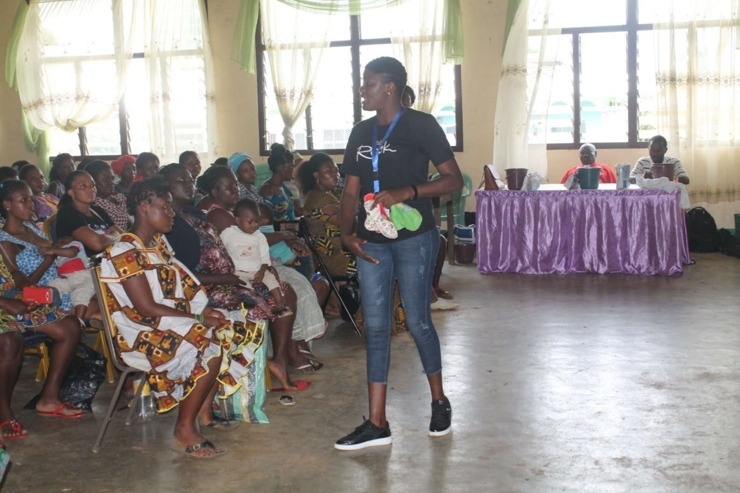
Presenting on how to make, use and manage reusable pads

Slide 18
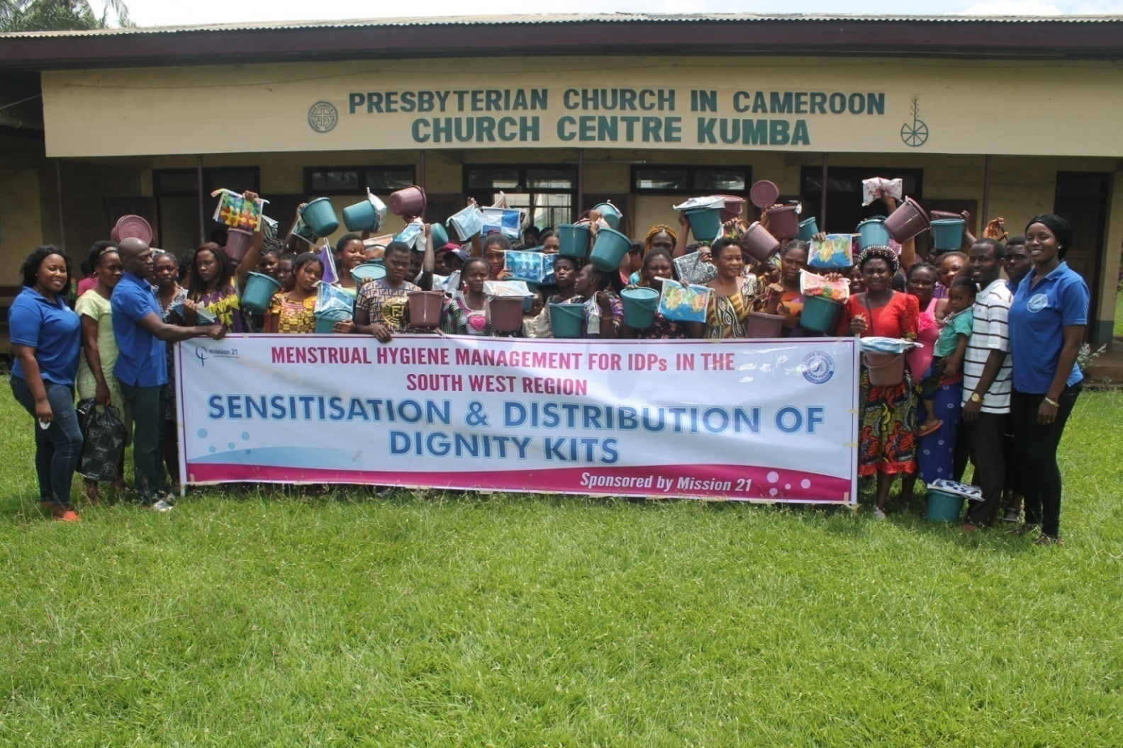
Dignity Kit distribution in Kumba

Slide 19
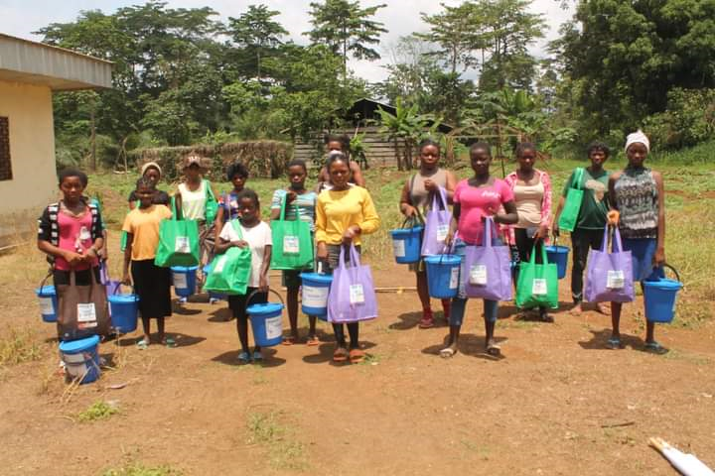
Distribution in Kwa Kwa

Slide 20
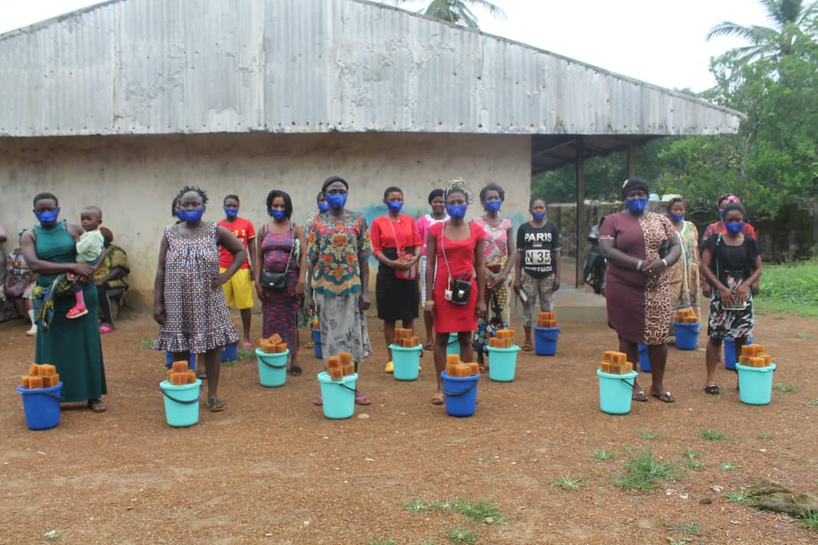
Distribution in Bisongabang

Slide 21
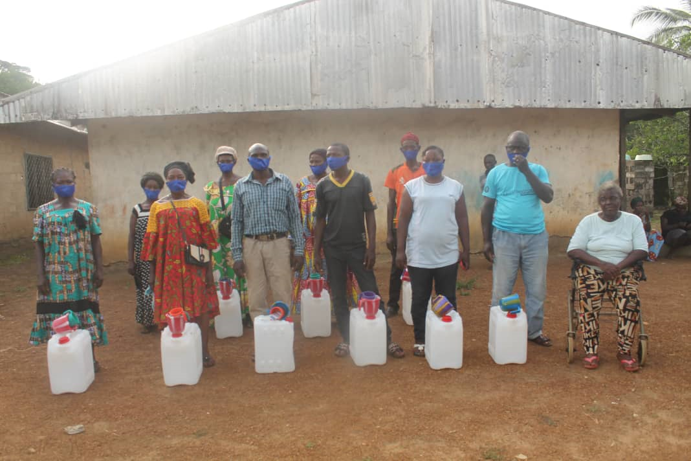
Distribution in Bisongabang

Slide 22
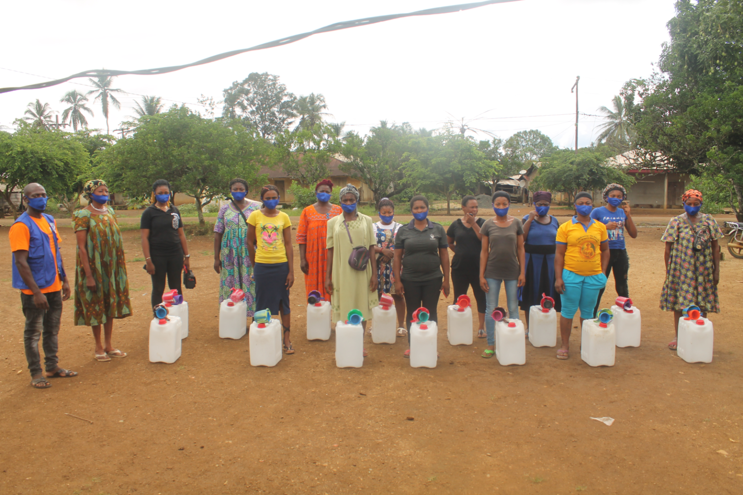
Distribution in Nchang

Slide 23
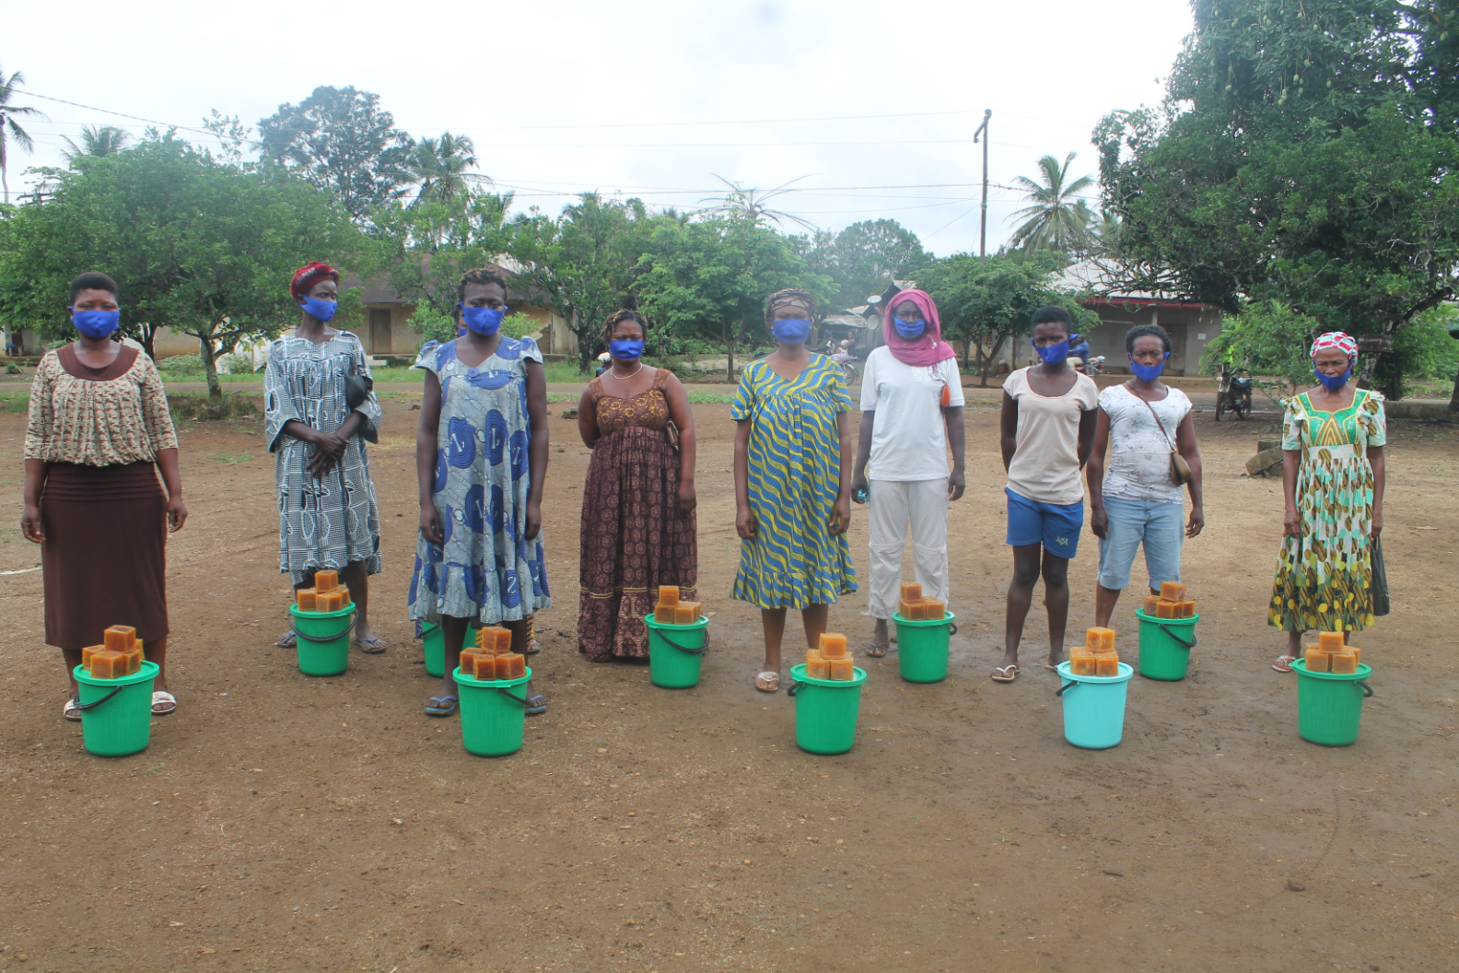
Distribution in Nchang

Slide 24
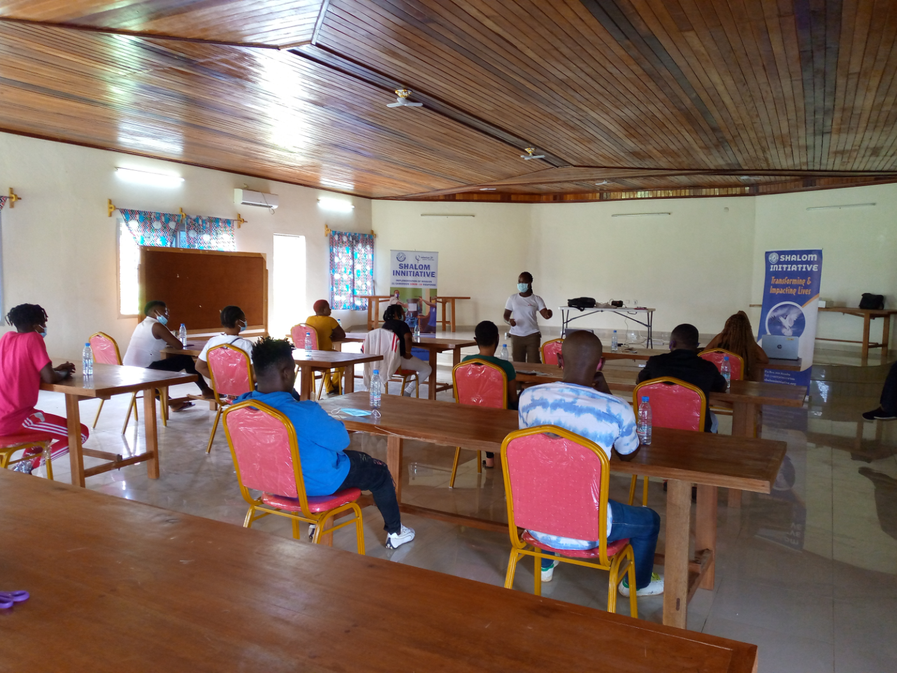
COVID – 19 Respond with Sex workers

Slide 25
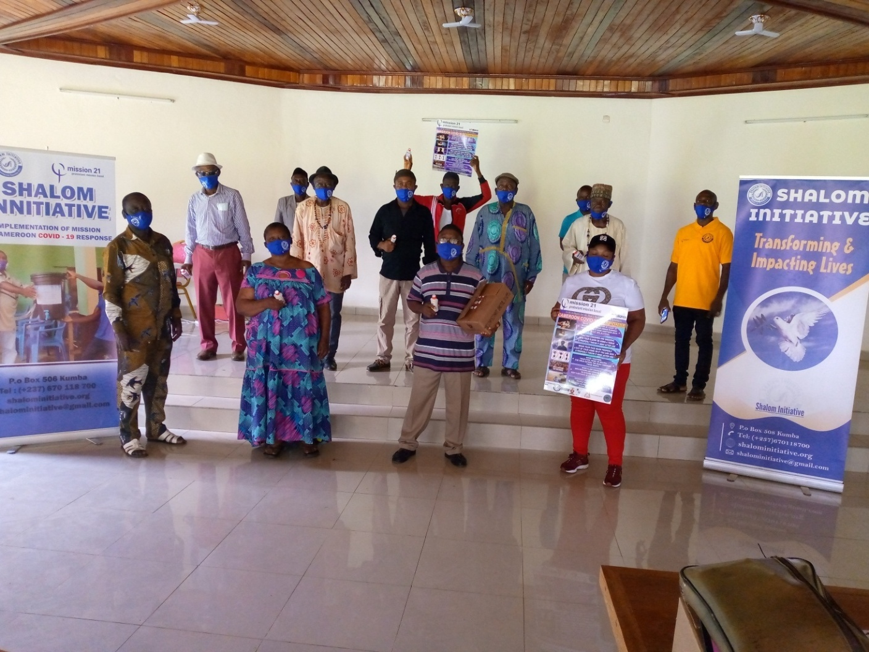
With traditional Rulers

Slide 26
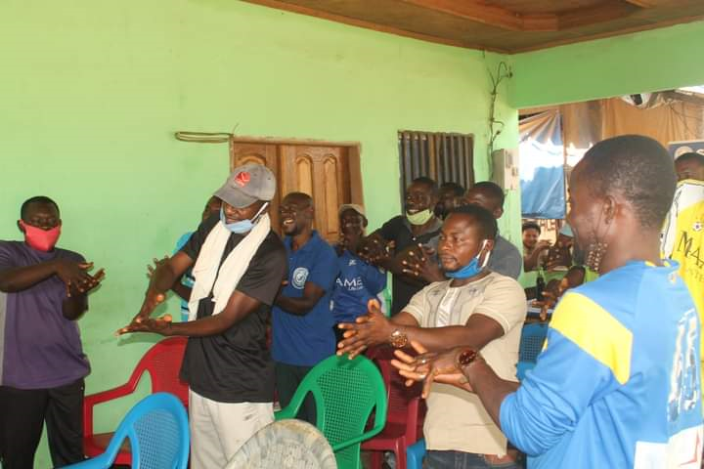
With Taxi Drivers

Slide 27
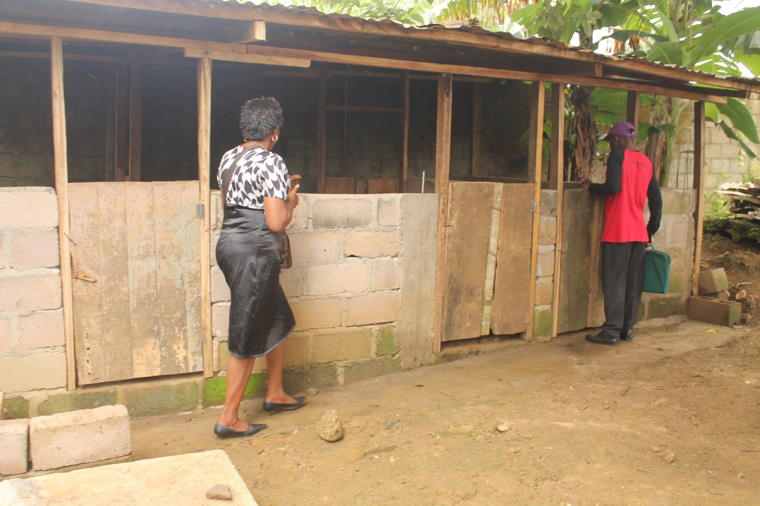
Agriculture

Slide 28
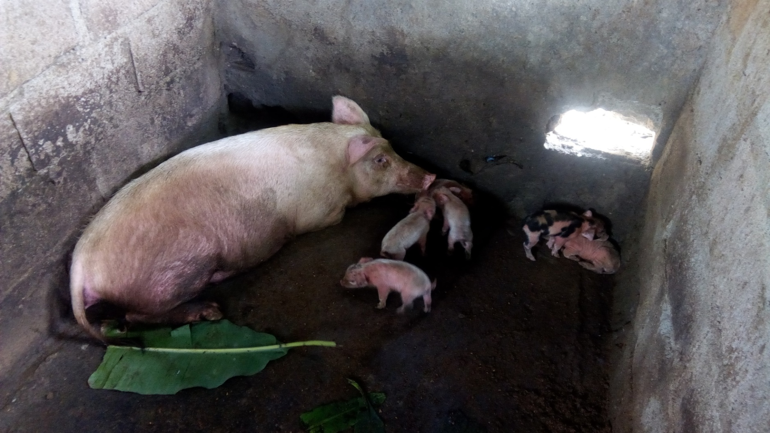
We hope to help the orphanages in Kumba through this project

Slide 29
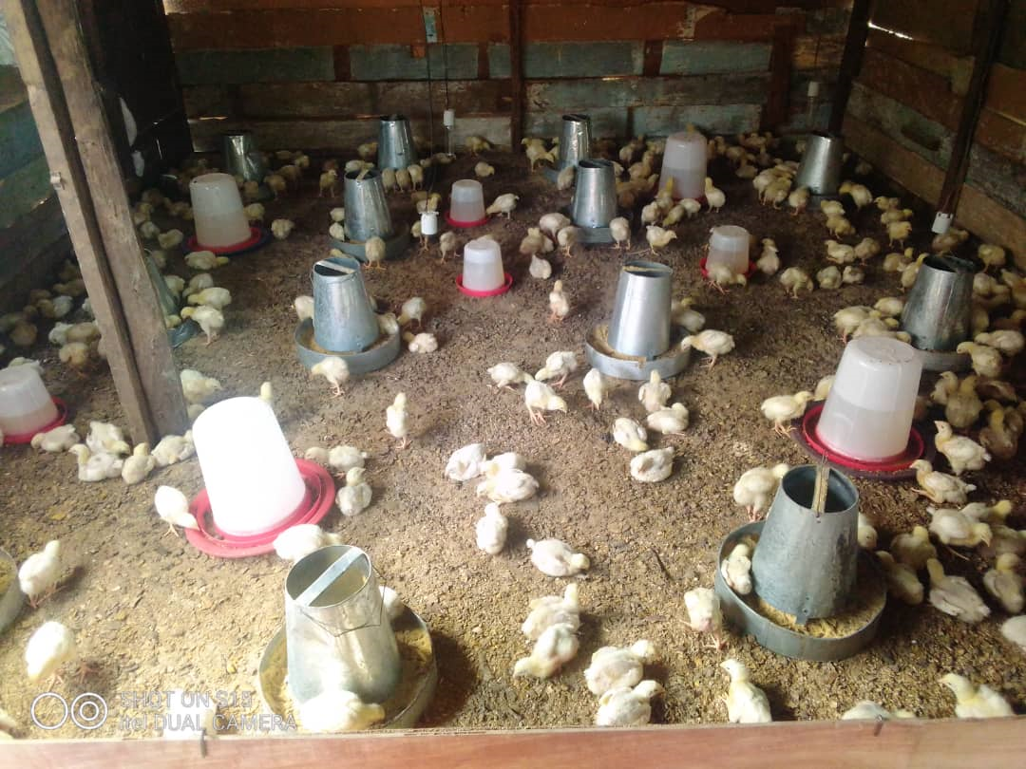
And to Raise Income for the organisation

Slide 30
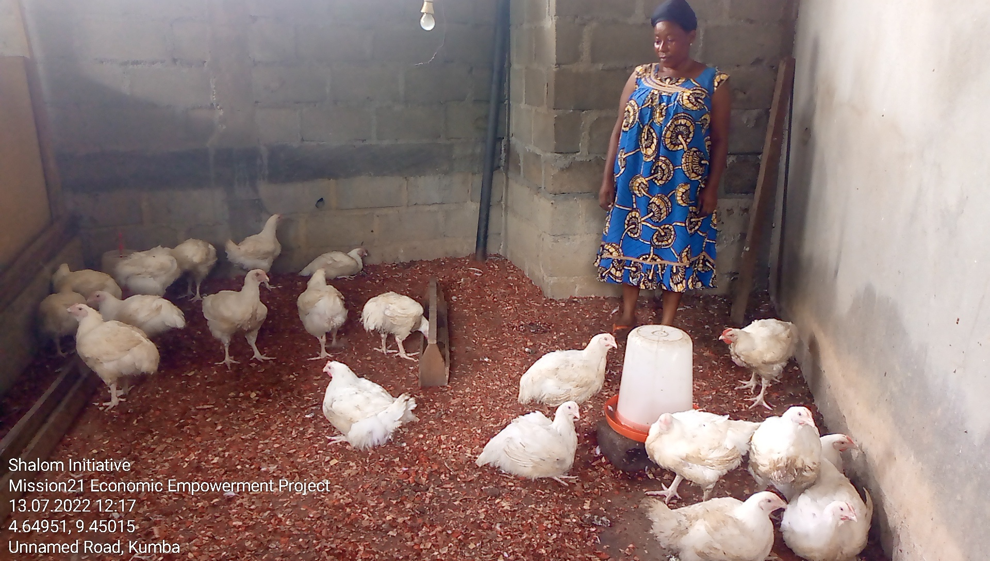
An Empowered Woman

Slide 31
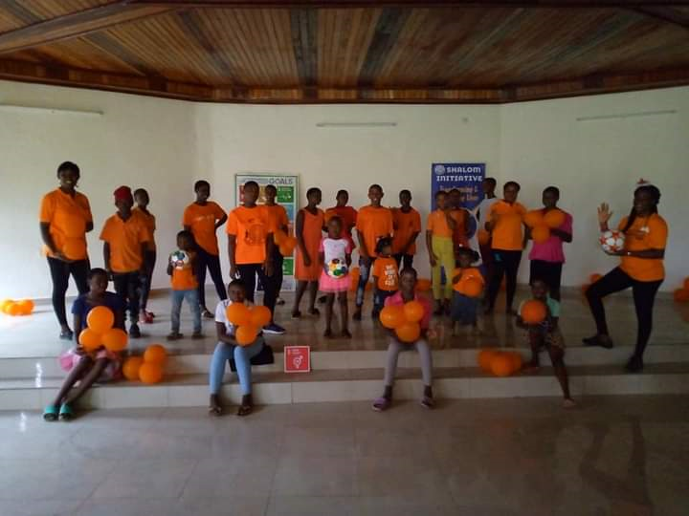
Gender Base Violence

Slide 32
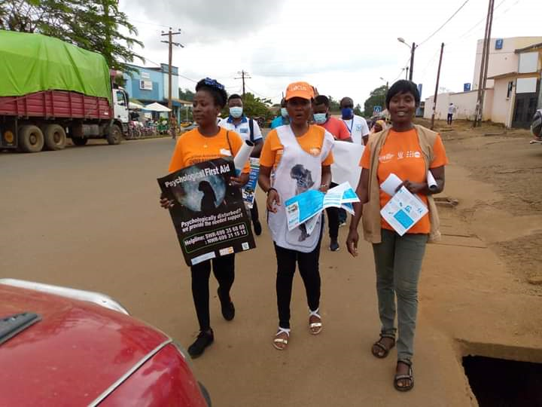
Community sensitzation

Slide 33
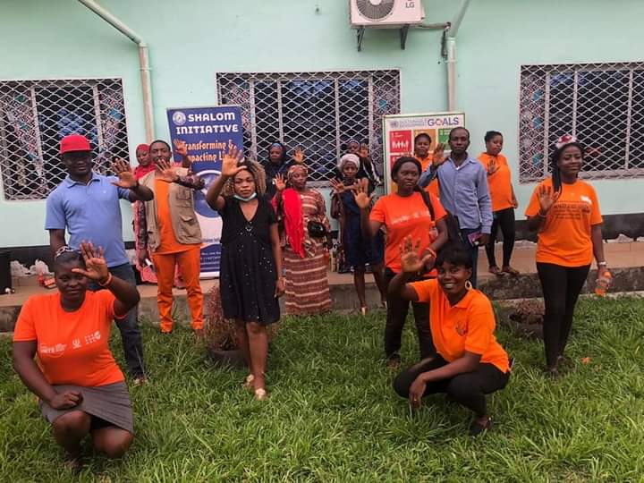
No to GBV

Slide 34
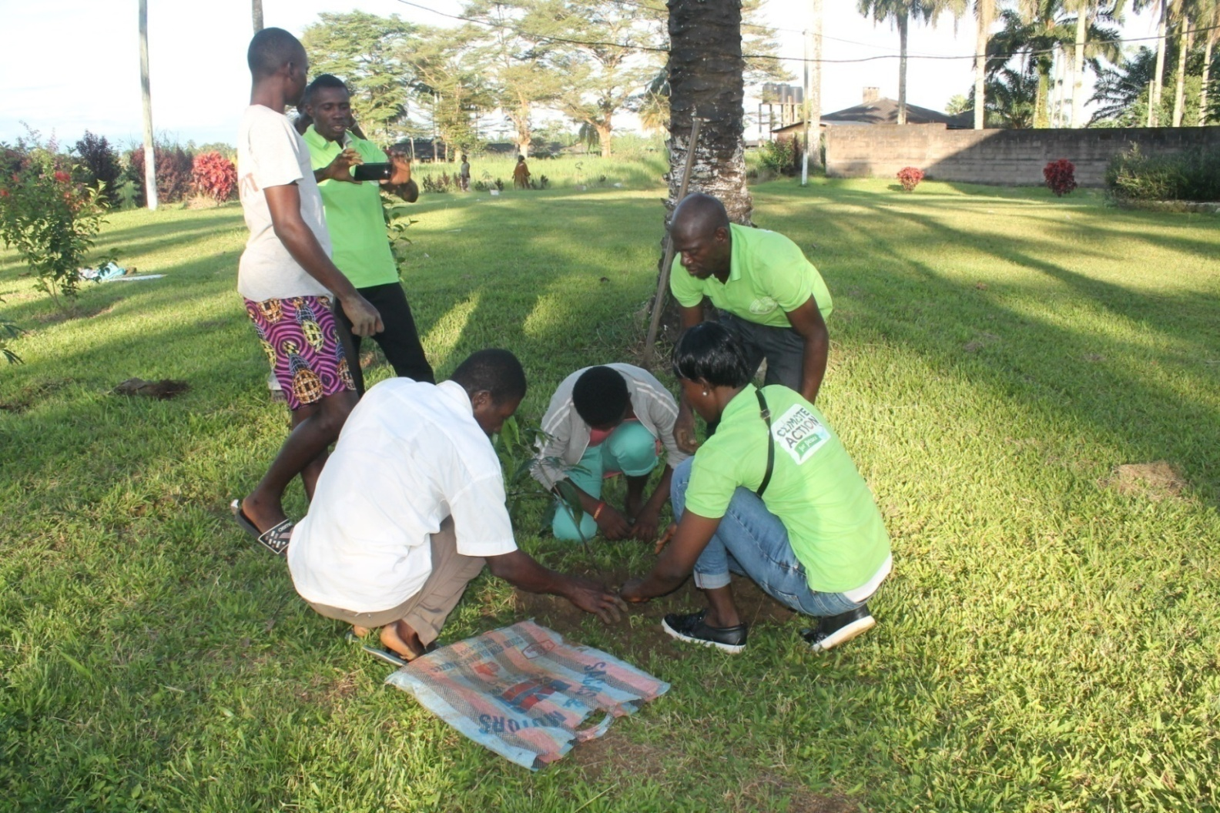
Climate Action (Planting of tree)

Slide 35
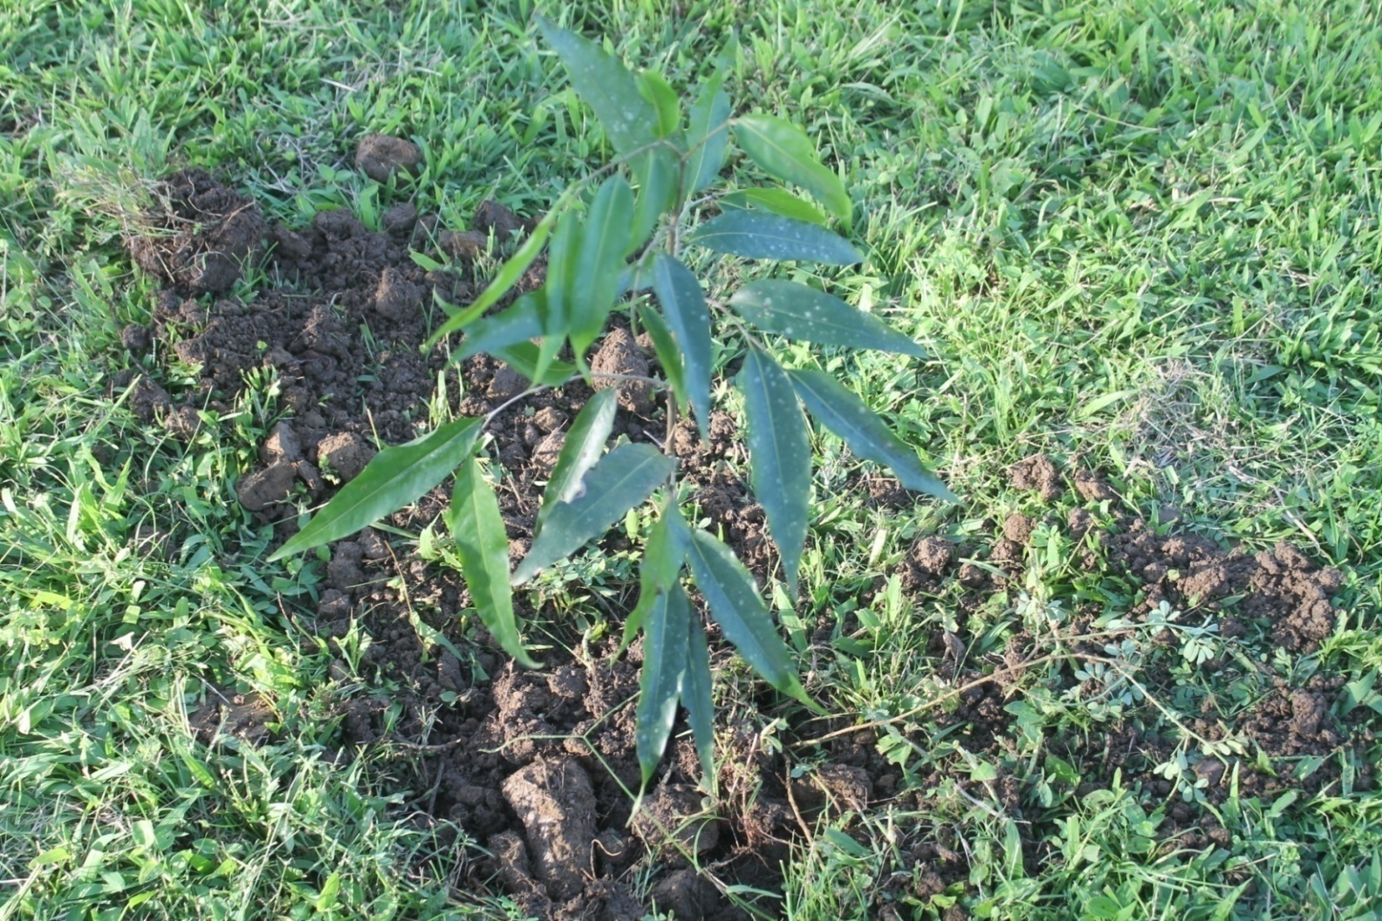
Tree

Slide 36
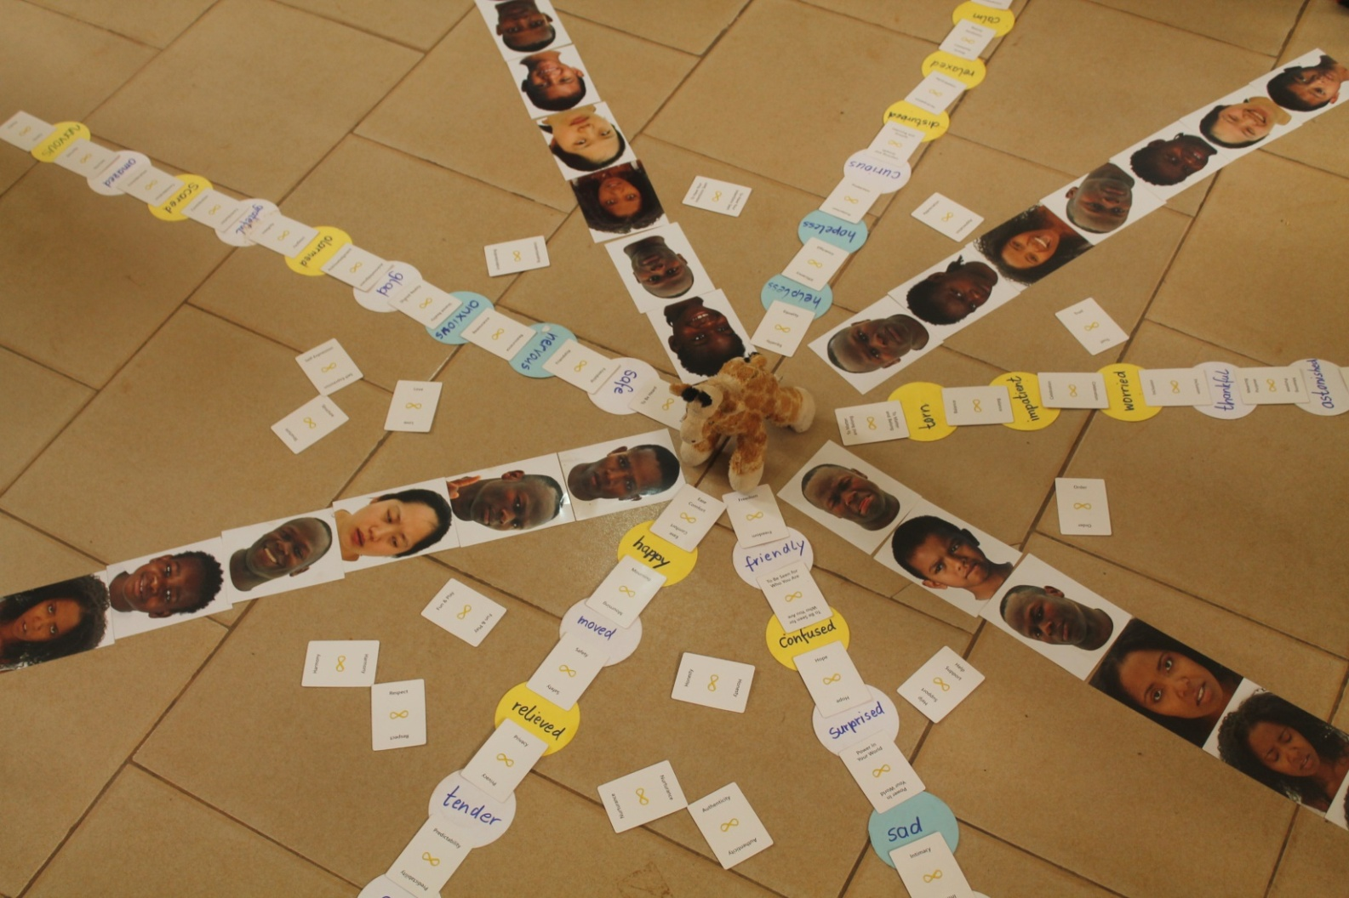
Peace Building Trainings

Slide 37
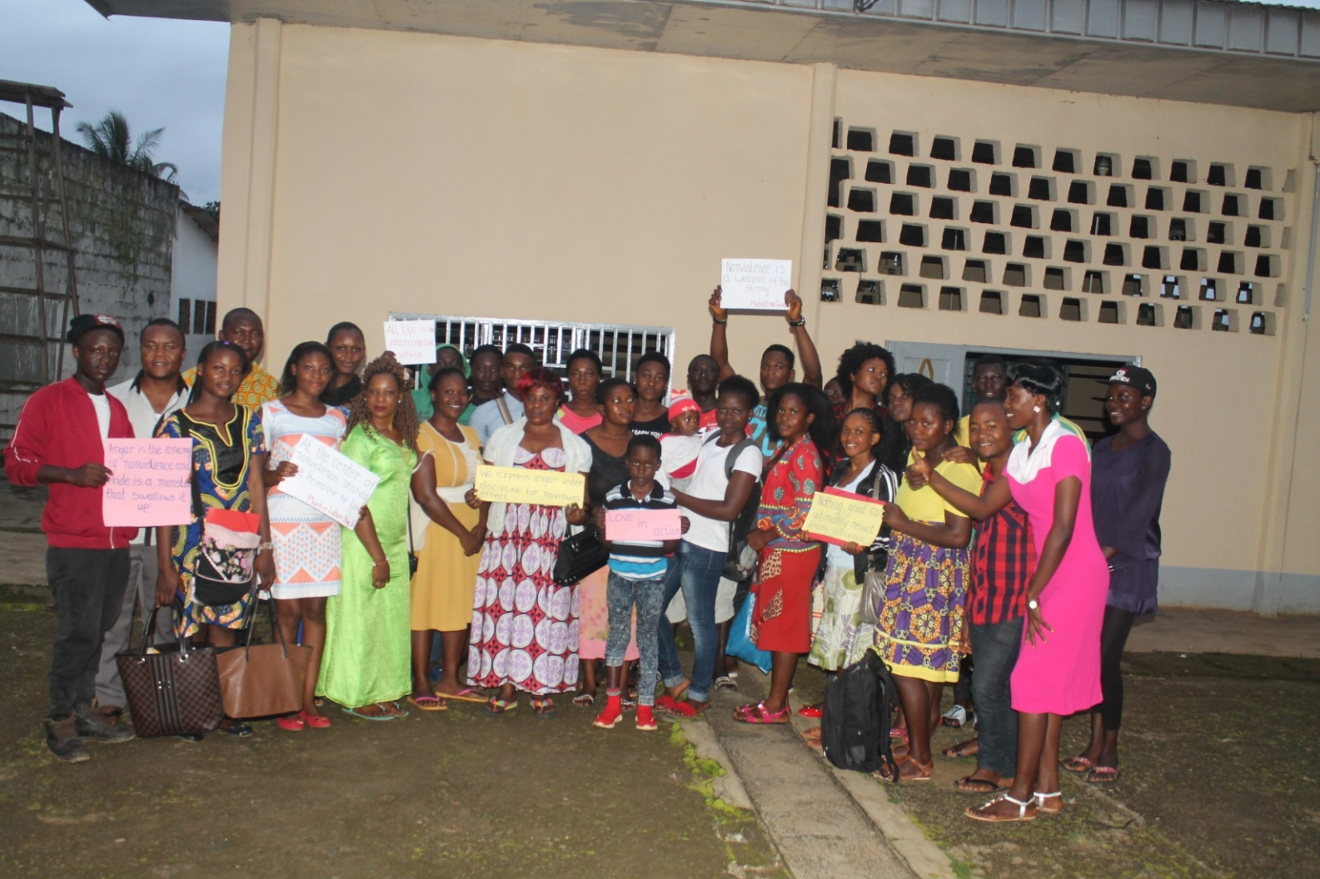
Group picture after training

Slide 38
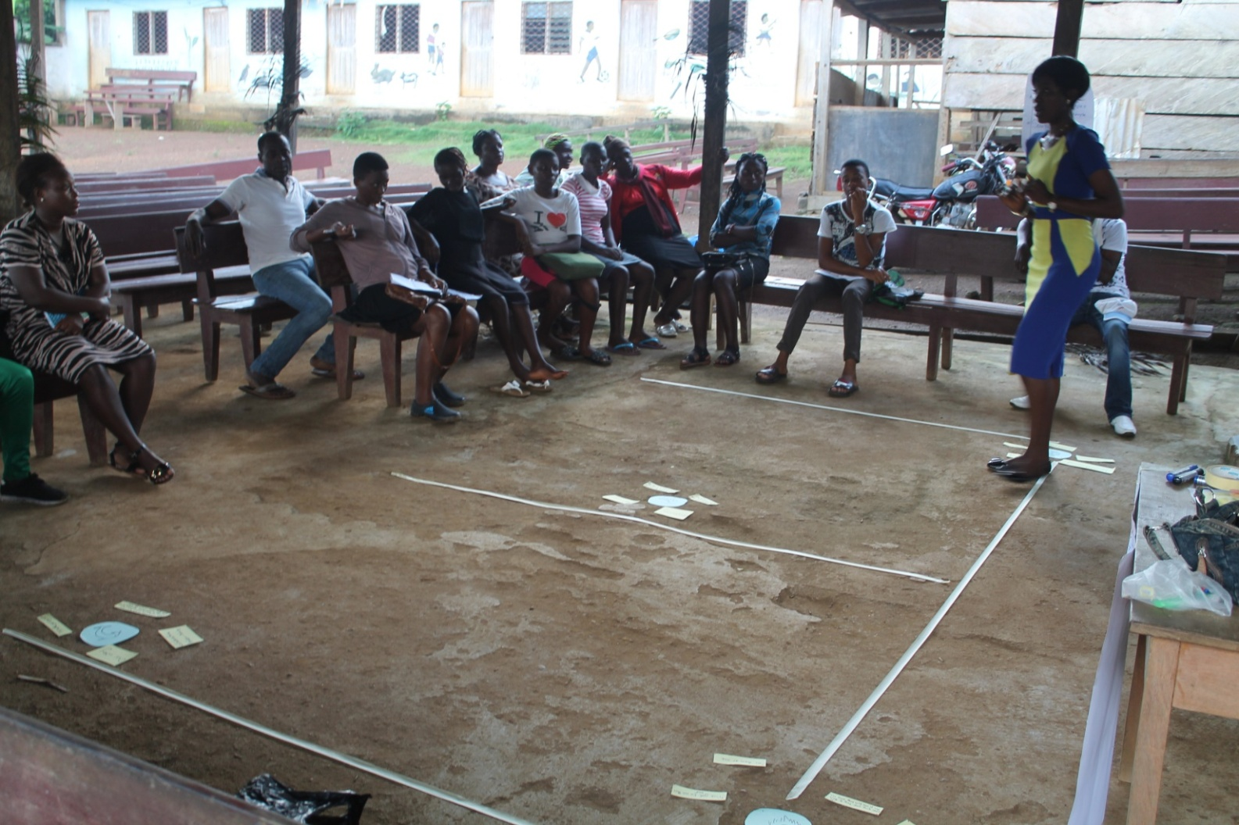
Training at Kosala II

Slide 39
What we plan to do before the end of 2022
Agriculture: Attend a training of trainers in palm weevils and mushroom farming this November in Limbe.
GBV: Participate effectively in the 16days activism against GBV from 25th November to 10 December.
Health: Community awareness and sensitization to commemorate world AIDS Day on 1st December.
Disability Day: Join other organisation 3rd December.
Human Rights Day. Radio talk on 10th December

Slide 40
What are our perspective
Building a good and committed team
Networking to have partners, funders or sponsors of Shalom Initiative starting from our local community.
Looking through our loopholes of 2022 to have a better and successful 2023

Slide 41
Partners or funders
We look forward to have other partners, funders. Sponsors or friends of Shalom Initiative (individual sponsors) for some of our projects
We beleive that if we can get other partners and funders it will go along way to meet the goals of our oganisation which is to transform and impact the lives of people in our community.

Slide 42
End of year 17th December
2022 Evaluation
Planification for 2023
End of Year Report
Christmas break begins

Slide 43
Thank You!
Danke!
Merci!

